Slide 1



Our Team
Alex Anto Cherian
Yasina Thasneem M
Vismey Sen

Slide 2



Everyday Problems We Face

Slide 3
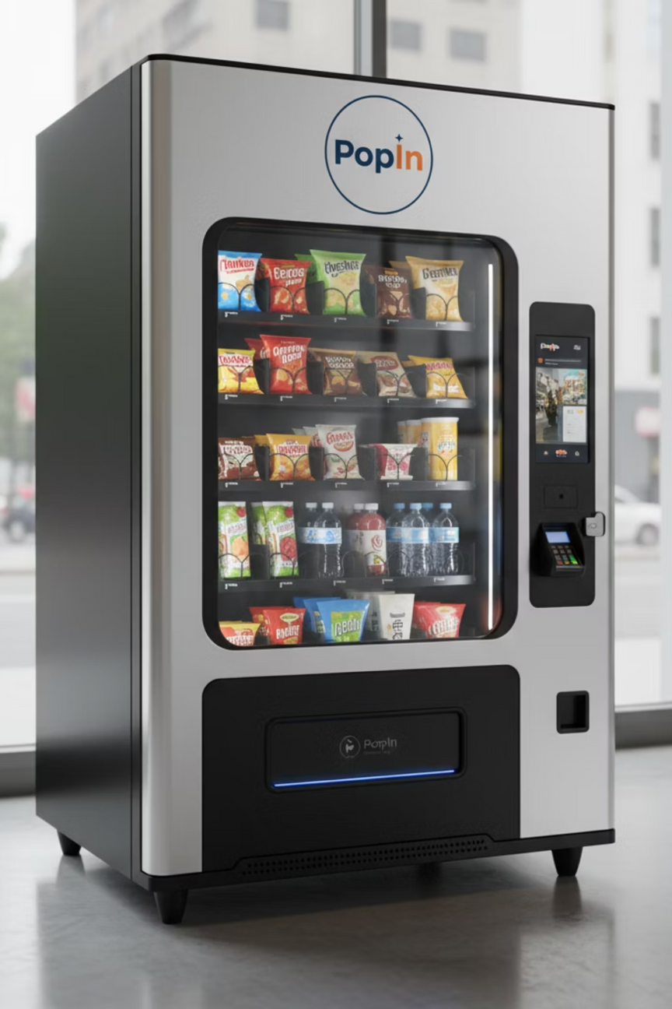



PopIn
Smart Vending Machine
24/7 Fresh Access
IoT & AI Intelligence
Premium Selection

Slide 4




Revenue Streams
Direct Sales
Direct sales earn 10–20% margin on premium items, with a ₹2 platform fee covering costs and boosting customer loyalty.
Brand Partnerships
Commission-based partnerships with Trustable brands for exclusive offerings
Digital Advertising
Premium ads ran on hologram technology

Slide 5
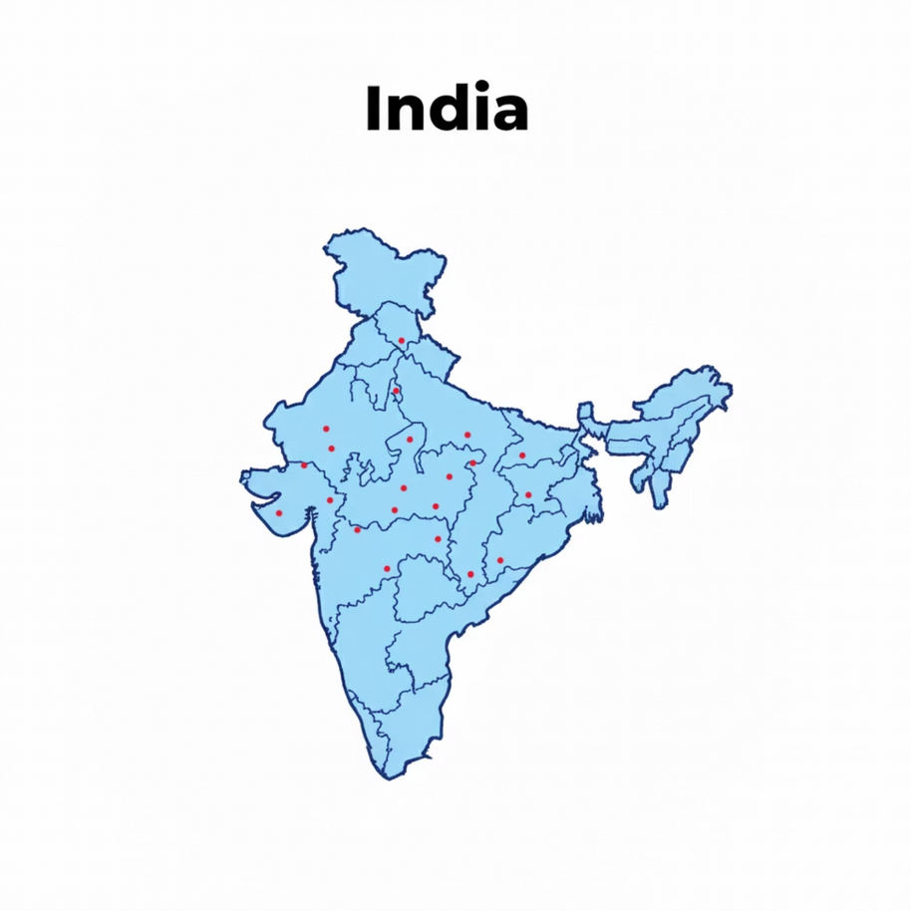
Market Opportunity
The vending machine market in India is currently concentrated in major metropolitan cities.
Smaller towns and emerging urban hubs remain largely untapped.
This gap offers a unique opportunity to create a new vending ecosystem.
Early entry enables market leadership and fosters new consumer habits nationwide.

Slide 6
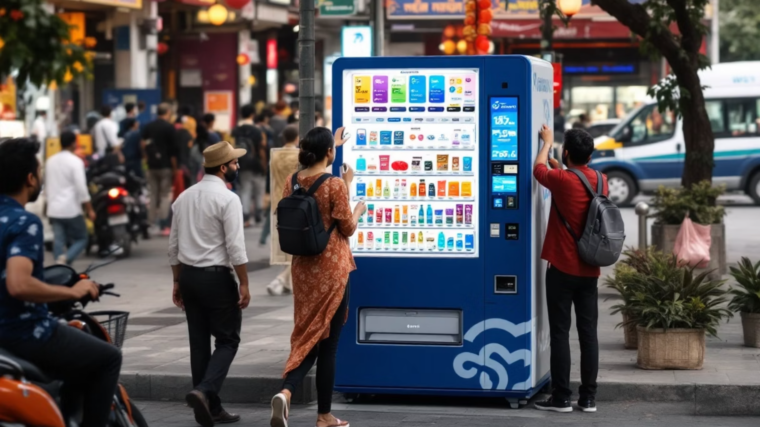

Smart Vending: India's $30.9B Opportunity
The Problem
1
Limited access to quick, healthy, affordable refreshments in public spaces and workplaces. India's vending ecosystem remains underdeveloped.
Market Size
2
Global vending market: $22.4B in 2025, projected $30.9B by 2033. CAGR of 4.11% with huge whitespace in Tier-2 cities.
Digital Revolution
3
UPI and cashless payments make vending frictionless. 24/7 work culture drives demand for instant solutions.

Slide 7
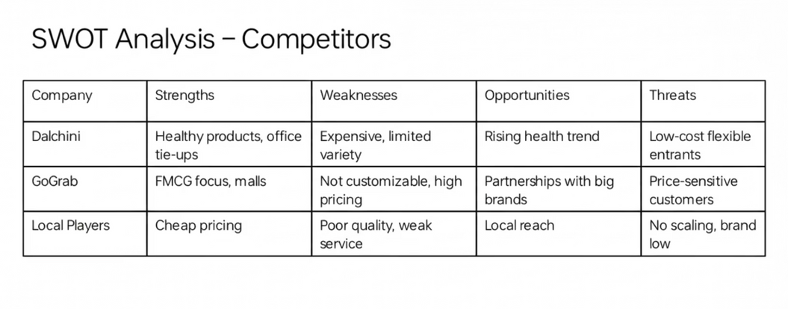
Competition & Market Advantage
Current Market Players
1
Dalchini
2
GoGrab
3
Local Players
Market Gap & Our Advantage
Unmet Market Needs
Our Competitive Edge
Customised machines for gyms and colleges
Location-first stocking strategy
Limited Tier-2 city penetration
Affordable ₹2 platform fee model
Inflexible pricing models
Multi-revenue streams approach

Slide 8
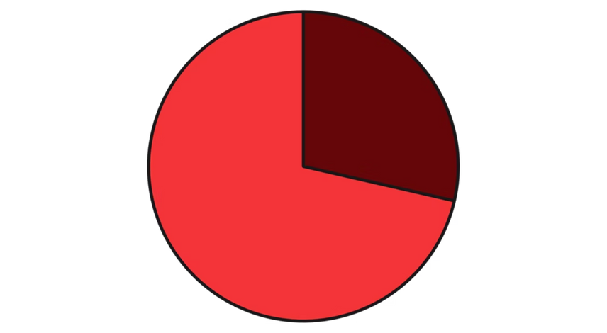

Go-to-Market Strategy
Phase 1 Pilot Financials
Revenue Breakdown
Pilot phase demonstrates strong unit economics with ₹21,000 monthly profit from 2 machines, validating customer demand and operational efficiency across college and gym environments.

Slide 9
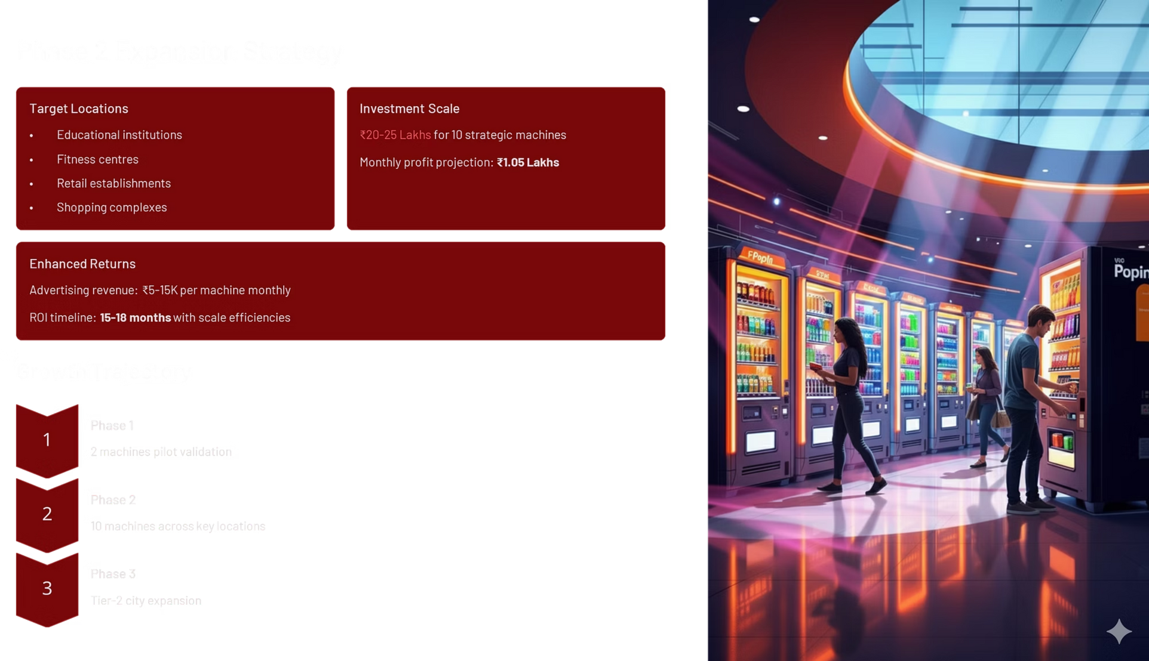

Slide 10

Investment Needed
Strategic Use of Funds
Hardware & Setup
Initial Stock
Branding & Placement
₹3,00,000
₹70,000
₹30,000
Working Capital
Tech & Contingency
₹70,000
₹30,000

